Slide 1
and Systems Thinking
Intro to Biomimicry
What is a system?

Slide 2
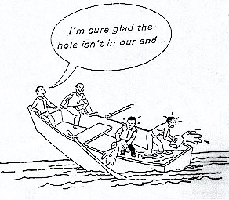
Goals for Today
Explore the basics of systems thinking
Get outside and explore natural systems

Slide 3
Dancing with Systems Discussion
Donella Meadows article lists 14 principles or guidelines for engaging in complex systems
Which ones resonated most with you? Why?
Which ones do you do well? Example?
Which ones do you want to do better?

Slide 4
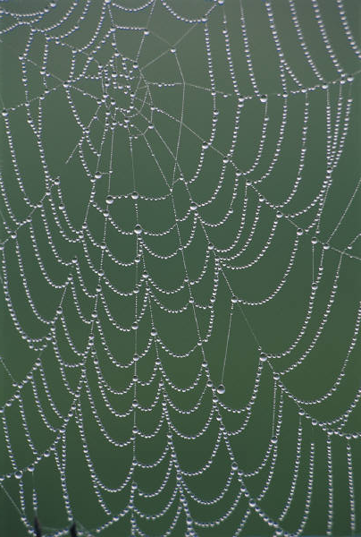
Systems Thinking
Capacity to understand and change complex systems
Notes:
Present or in notebooks only?
Seeing trends
Finding drivers
Finding leverage
Seeing delays and momentum
Blaming system not players
Communicating from systems base
Understanding of link between ST and natural systems

Slide 5
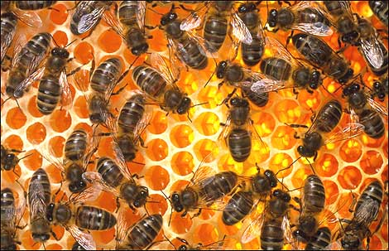
Definition of a System
“A system is an interconnected set of elements that is coherently organized in a way that achieves something. …a system must consist of three kinds of things:
elements,
interconnections and
function or purpose.”
- Donella Meadows, Thinking in Systems

Slide 6
Components of a System
Material “stuff” – often the most visible, tangible part
People, trees, water, buildings, highways, cars
Flows of information that connects “the stuff” – laws, rules, beliefs, decision making processes, cause and effect relationships
The price of gasoline, the advertizing that promotes this year’s new model of automobile, the word of mouth about the performance of the new model, the interest rate, the traffic congestion, the level of concern about climate change, the impact on trees of air pollution
Systems are usually embedded in larger systems and contain sub-systems within themselves

Slide 7
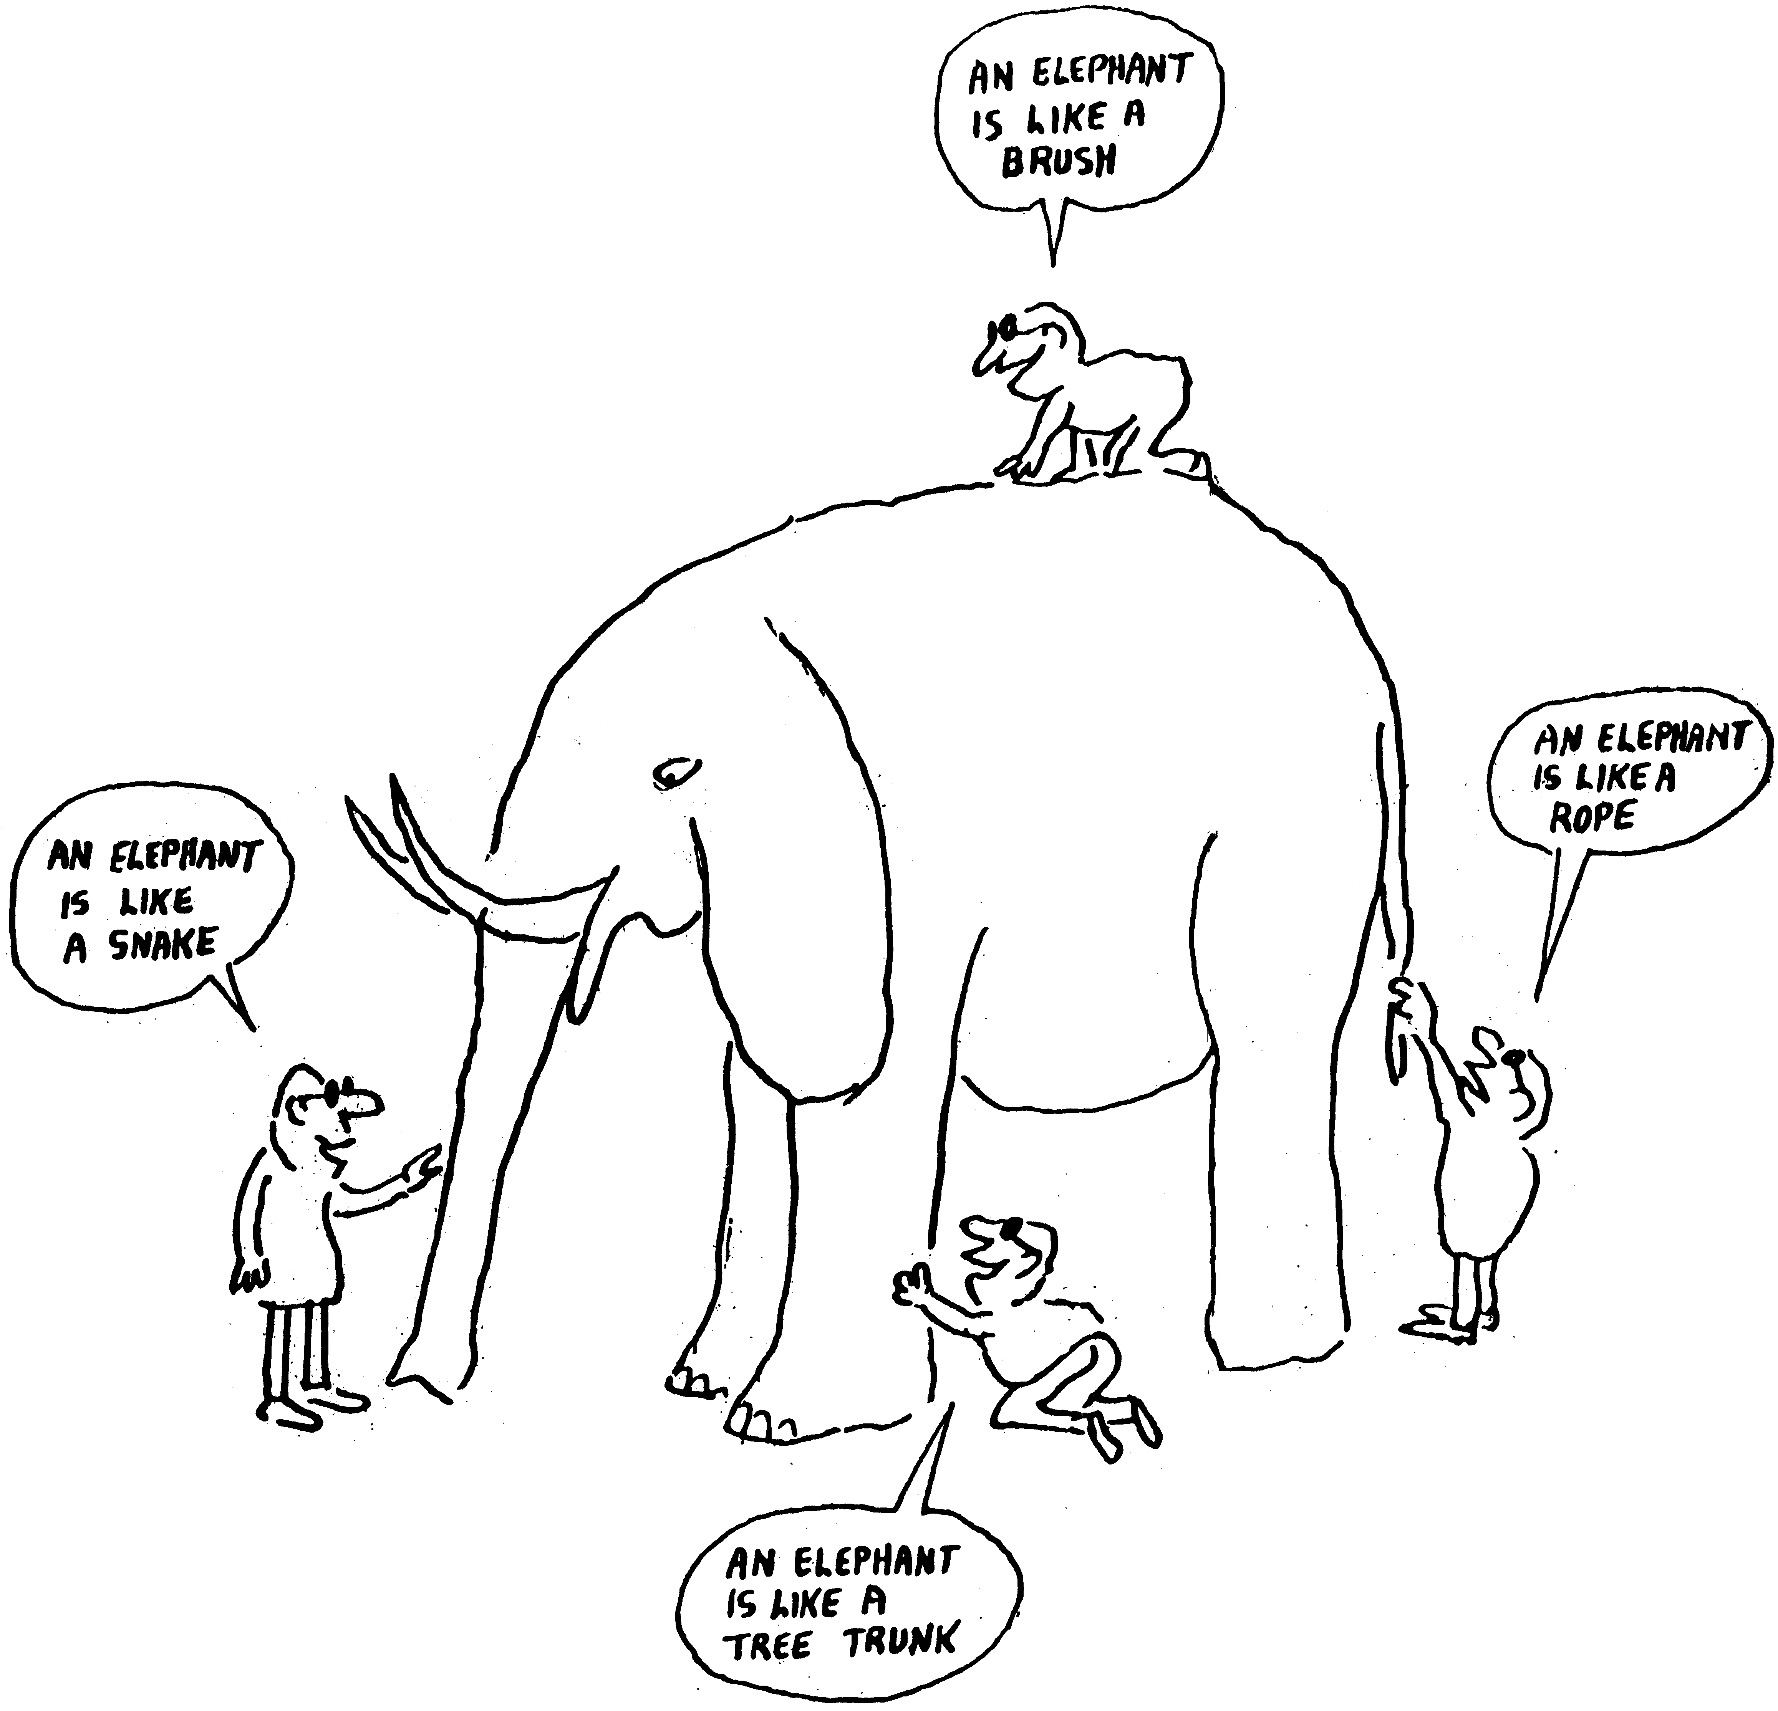
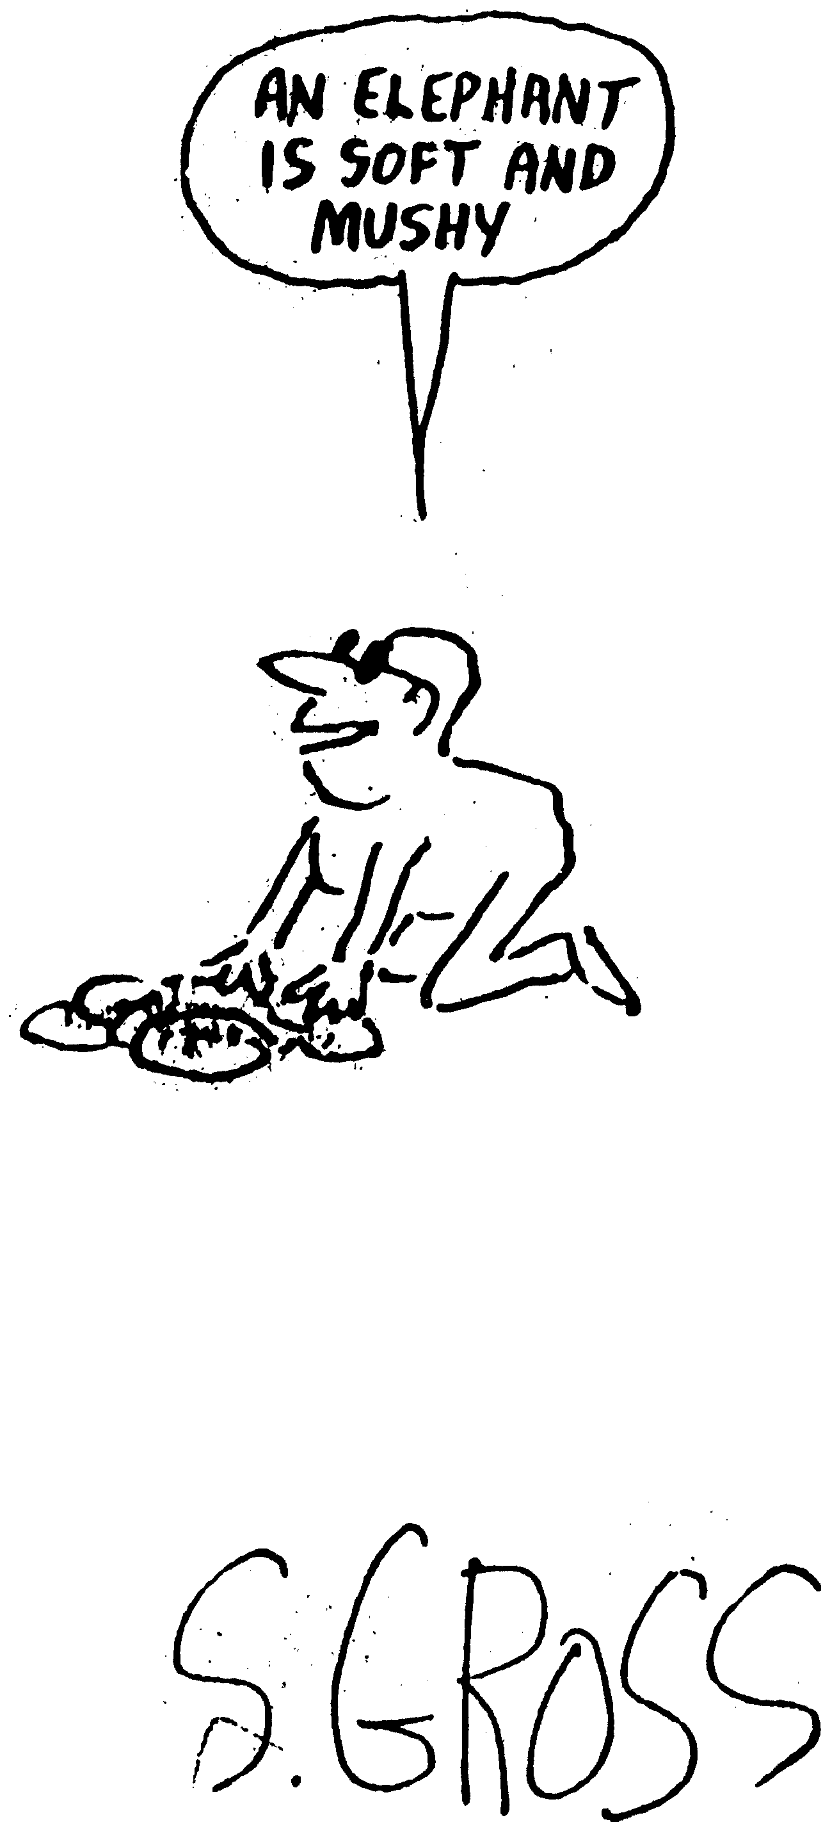
Systems thinking helps us see the larger picture.

Slide 8
Benefits of Systems Thinking
Promotes exploration of assumptions
Helps strategizing about leverage, places to intervene to ‘steer’ or ‘dance with’ the systems we participate in
Helps show the similarities between seemingly different systems, so that learning about one can inform responses in another
Can be taken to the level of computer simulation when complexity increases beyond what our minds can ‘simulate’

Slide 9
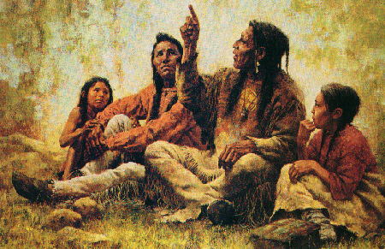
Trying to Grasp and Describe Principles of Our Experience
Systems thinking is one subculture’s effort to uncover underlying principles of the way nature works and to understand, respect and operate by them.
Every culture and period has had to grapple with the realities of complex systems. The resulting tales, stories, practices, art works, songs, etc. are all examples of systems thinking.
Biomimicry studies nature’s systems

Slide 10
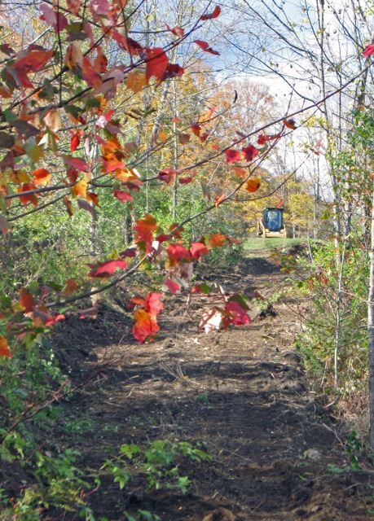
Outside – Journal
What 3 systems in nature did you observe?
What are the main parts of each natural system you chose?
What natural system do you most identify with?
What can you learn from that natural system?

Slide 11
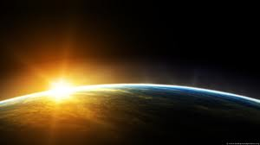
Homework – Journal
What systems are you a part of?
Which natural systems do you know best?
Reflections from today
Decorate journal with nature pictures

